Slide 1
Maths in the EYFS.
Notes:
ANNA

Slide 2
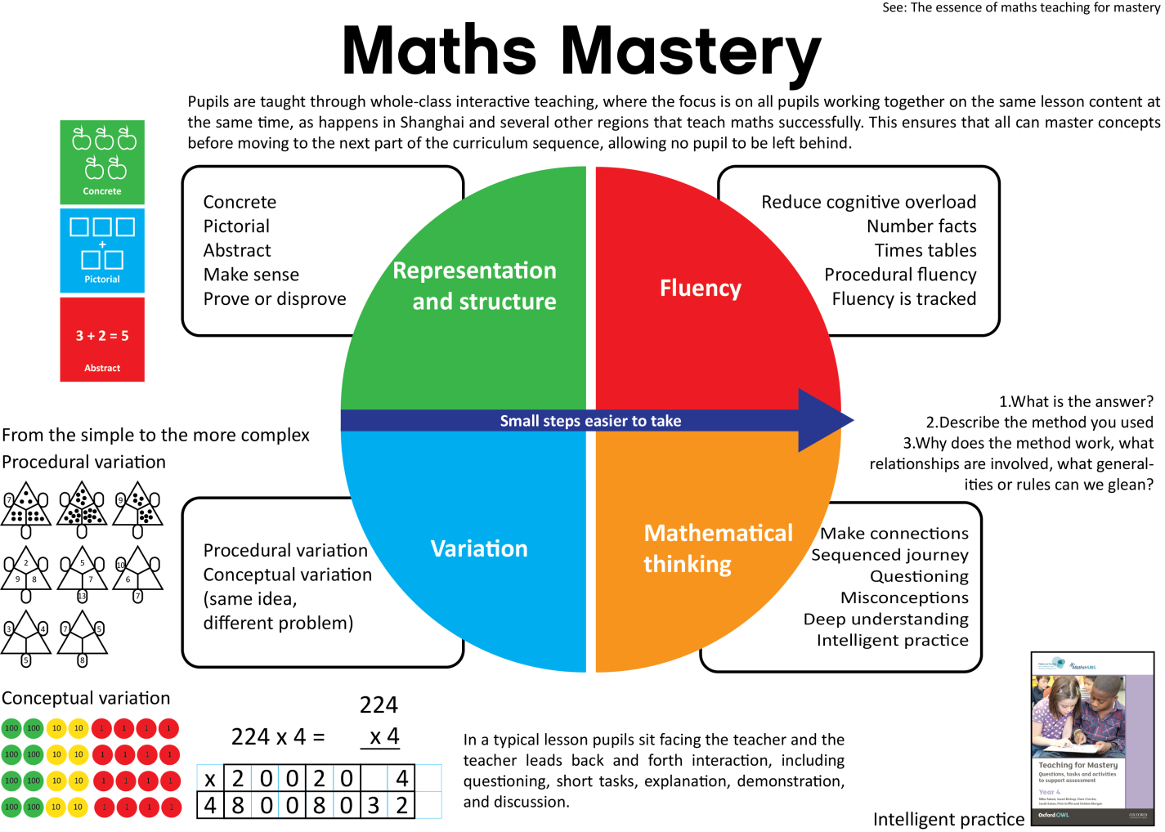
We now use a new Mathematics scheme of work called White Rose. This scheme focuses on deepening children’s understanding before moving on to new content. The idea is that children totally master a concept before moving on.
Notes:
ANNA

Slide 3
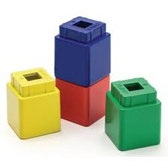
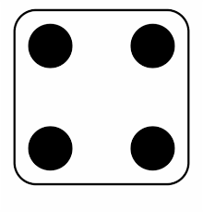
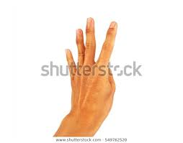
Number of the day- 4 Key Images
Notes:
ANNA

Slide 4
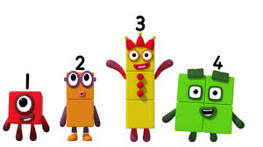
Numberblocks on cbeebies is a very good example of encouraging a deeper understanding of the concept of a numeral. In this clip you will see different pictorial representations of 4 alongside more abstract concepts like number sentences.
https://www.bbc.co.uk/iplayer/episode/b08d61cv/numberblocks-series-1-four
Notes:
JANINE

Slide 5
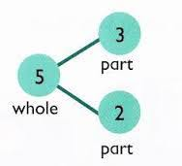
Addition and subtraction begins with sorting objects into groups. We use a model called ‘Part, Part, Whole.’ Initially this would begin with objects then moving on to using numerals.
Notes:
JANINE

Slide 6
This clip shows a Year One lesson on Part Part Whole. It shows what we are aiming for.
You will see the children talking to each other and collaborating in order to develop their problem solving skills.
You will see them using…
Concrete methods- moving and turning over double sided counters
Pictorial methods- drawing counters on the roads to represent cars
Abstract methods- writing number sentences in a variation of ways.
https://www.ncetm.org.uk/resources/49419
Notes:
JANINE

Slide 7
Fluency is very important to successful mathematical thinking.
The children will learn number facts.
Activity- Who can use the Part Part whole model to show all the number bonds to 5?
Draw a the model on your whiteboard. Draw 5 dots in the top circle. Show different ways to make 5.
The idea is the children will go over and practise these facts so many times that they will remember them.
Notes:
ANNA

Slide 8
We can then deepen their understanding of the number bonds and help them apply this knowledge to problems. Can you see a pattern in these number sentences?
The numbers on this side increase by 1 every time
Can you think of another way to represent a number bond to 5? Write it on your whiteboard!
1+4=5
2+3=5
3+2=5
4+1=5
Some examples….
1+1+1+1+1=5
1+1+1+2=5
1+1+3=5
5=4+1
5=3+2
Etc…
The numbers on this side decrease by 1 every time
Notes:
ANNA

Slide 9
We can also use this knowledge of number bonds to count objects accurately.
You will not need to physically count these dots to know how many there are…
Our brains find it easy to see up to 6 objects in a regular pattern and know how many there are without actually counting them. Your children are starting to be able to do this.
More than 6 objects is harder… but we can use our knowledge of number bonds to help us with larger numbers…
Notes:
ANNA

Slide 10
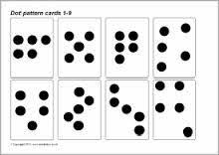
Notes:
ANNA

Slide 11
A key technique we use to develop mastery of a mathematical concept is to encourage the children to use talk and play to work through a problem.
In this video you will see the children develop the following skills…
Questioning
Reasoning
Explaining
Collaborating
Can you spot all of these skills in practise?
https://www.youtube.com/watch?v=7vfMkqBqYs4
Notes:
JANINE

Slide 12
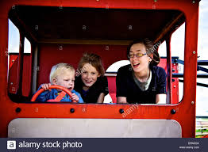
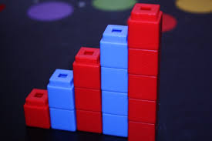
We will also encourage children to learn through play independently.
For example when we are learning about 1 more, we may play bus stops when we have the bikes out. When we are playing with the children we will ask them to stop off at bus stops and let 1 more child on.
Or we may use construction toys like blocks or lego to make different kinds of staircases. While we are playing we might say, the next tower needs one more to complete the staircase.
Notes:
JANINE

Slide 13
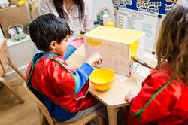
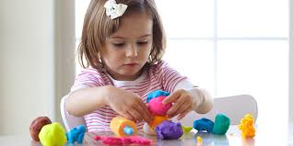
We teach key concepts of Shape Space and Measure through play.
For example, the children may be able remember the names of the 3D shapes, but we deepen their geometrical understanding of these shapes through concrete experiences.
Dough-
We may ask children to make a 3d shape with dough then ask questions such as…
“Which shapes are easiest/ hardest to make a why?”
“What equipment can you use to make that face flat?”
Junk Modelling-
We may ask children to make models for different purposes- ie a bridge for the Billy Goats to cross.
We would ask questions such as…
“Which shapes are easy/ hard to fasten together and why?”
Notes:
JANINE

Slide 14
What is the end of year expectation for number?
Early Learning Goal-
“Children count reliably with numbers from one to 20, place them in order and say which number is one more or one less than a given number. Using quantities and objects, they add and subtract two single-digit numbers and count on or back to find the answer. They solve problems, including doubling, halving and sharing.”
Notes:
ANNA

Slide 15
What is the end of year expectation for ‘Shape Space and Measure?
Early Learning Goal-
“Children use everyday language to talk about size, weight, capacity, position, distance, time and money to compare quantities and objects and to solve problems. They recognise, create and describe patterns. They explore characteristics of everyday objects and shapes and use mathematical language to describe them.”
Notes:
ANNA

Slide 16
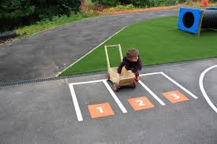
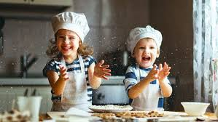
How can you help at home?
Learn number facts like number bonds to 5 and 10 or doubles.
Sing counting songs - 5 little ducks etc.
Introduce maths into play situations.
Introduce maths into every day situations such as cooking or shopping.
Encourage children to make mistakes! Building resilience and knowing that making mistakes is an important part of learning is extremely important.
Notes:
ANNA

